Slide 1
How to Get Rid of Tacos
A presentation by Lettie O. Lantigua, professor in Molecular Tacos Studies
Notes:
Seed: tacos Generator: Title slide Context: {'topic': 'tacos', 'presenter': 'Lettie O. Lantigua', 'seed': 'tacos', 'seed_plural_title': 'Tacos', 'seed_title': 'Tacos'} Generated Elements: ['How to Get Rid of Tacos', 'A presentation by Lettie O. Lantigua, professor in Molecular Tacos Studies']

Slide 2
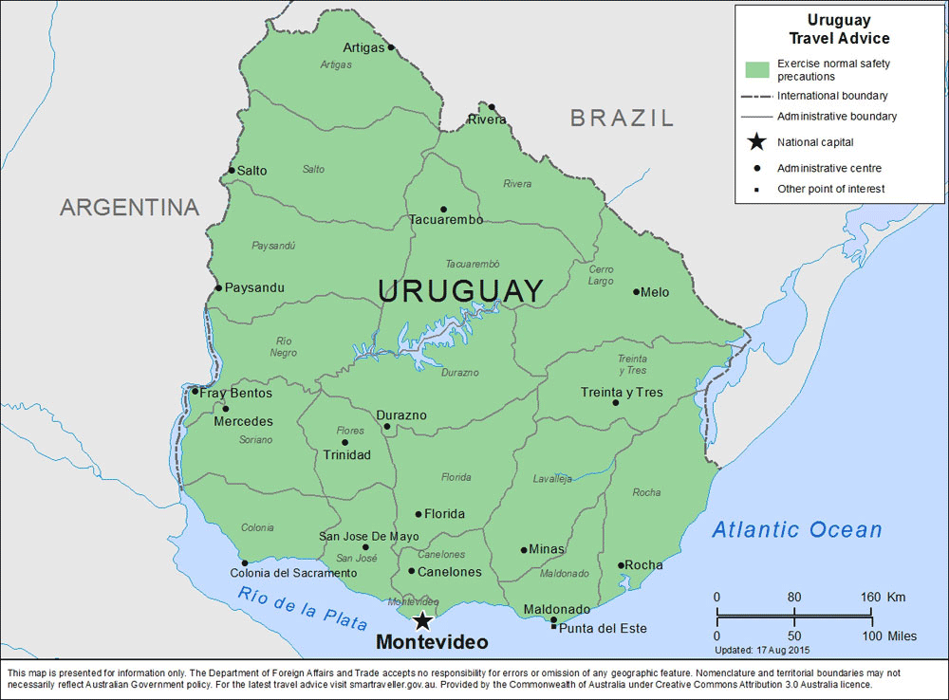

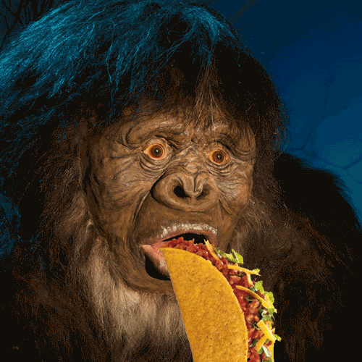
Who am I?
Uruguay
Arbitrator
How I spend my free time
Notes:
Seed: taco Generator: About Me: Location-Job-WeirdHobby Context: {'topic': 'tacos', 'presenter': 'Lettie O. Lantigua', 'seed': 'taco'} Generated Elements: ('Who am I?', 'Uruguay', '/downloads/google_images/Uruguay/uruguay.png', 'Arbitrator', '/downloads/google_images/Arbitrator/represent-yourself-car-accident-los-angeles.png', 'How I spend my free time', '/app/talkgenerator/schema/../../downloads/reddit/hmmm+hmm+wtf+wtfstockphotos+photoshopbattles+confusing_perspective+cursedimages+HybridAnimals+EyeBleach+natureismetal/Q4fhS.gif', True)

Slide 3
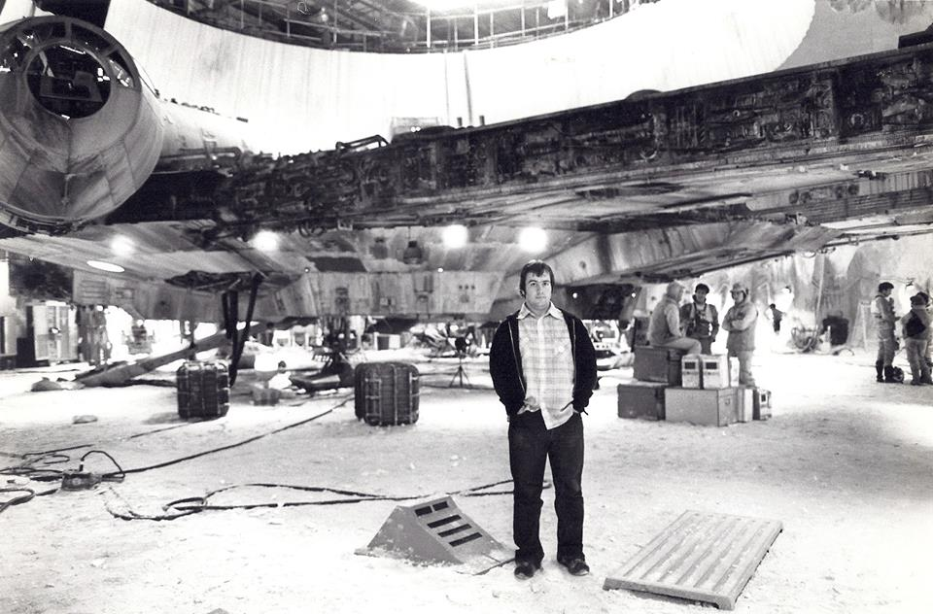
The First Person to Treat Female Hair Loss 924,328 views ExpertCo-Authored Updated 1 month ago
"Explora mil vulvas, rapaz. Suga mil pénis, rapariga. Forniquem com fúria a juventude. Só assim respeitarão, em pleno, a derradeira e sagrada união."
Professor Bruno Gooden
Notes:
Seed: vulva Generator: Historical Figure Quote Context: {'topic': 'tacos', 'presenter': 'Lettie O. Lantigua', 'seed': 'vulva', 'seed_wikihow_action': 'Treat Female Hair Loss\n\n\n\n\n\t\t\t\t\t\t924,328 views\t\t\t\t\t\n\n\n\t\t\t\t\t\t\tExpertCo-Authored\t\t\t\t\t\t\n\n\n\t\t\t\t\t\tUpdated 1 month ago\t\t\t\t\t\n\n\n\n\n\n\n'} Generated Elements: ['The First Person to Treat Female Hair Loss\n\n\n\n\n\t\t\t\t\t\t924,328 views\t\t\t\t\t\n\n\n\t\t\t\t\t\t\tExpertCo-Authored\t\t\t\t\t\t\n\n\n\t\t\t\t\t\tUpdated 1 month ago\t\t\t\t\t\n\n\n\n\n\n\n', 'Professor Bruno Gooden', '/app/talkgenerator/schema/../../downloads/reddit/OldSchoolCool/jdchh14losl21.jpg', None, '"Explora mil vulvas, rapaz. Suga mil pénis, rapariga. Forniquem com fúria a juventude. Só assim respeitarão, em pleno, a derradeira e sagrada união."', True]

Slide 4


What about Cracks?
Don't
Do
Notes:
Seed: crack Generator: Two Captions Weird Context: {'topic': 'tacos', 'presenter': 'Lettie O. Lantigua', 'seed': 'crack', 'seed_is_noun_plural_title': 'Cracks'} Generated Elements: ('What about Cracks?', "Don't", '/app/talkgenerator/schema/../../downloads/reddit/gifs+gif+gifextra+nonononoYES/3hbXNdH.gif', 'Do', '/app/talkgenerator/schema/../../downloads/shitpostbot/spongebob-through-crack-5829195ec0954.png', True)

Slide 5


Discussion
Previously
Currently
Notes:
Seed: noise Generator: Two Captions Gifs Context: {'topic': 'tacos', 'presenter': 'Lettie O. Lantigua', 'seed': 'noise'} Generated Elements: ('Discussion', 'Previously', '/app/talkgenerator/schema/../../downloads/reddit/gifs+gif+gifextra+nonononoYES/tumblr_m6g83agFT01qmqy5mo1_400.gif', 'Currently', '/app/talkgenerator/schema/../../downloads/reddit/gifs+gif+gifextra+nonononoYES/giphy.gif', True)

Slide 6
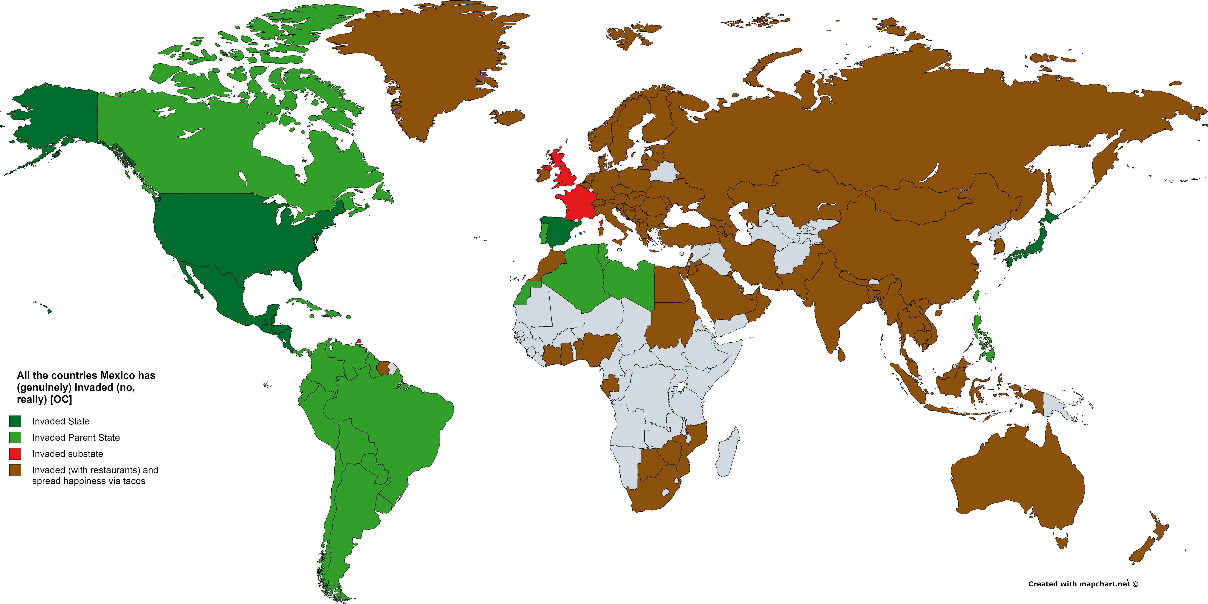
Notes:
Seed: tacos Generator: Reddit Chart Context: {'topic': 'tacos', 'presenter': 'Lettie O. Lantigua', 'seed': 'tacos'} Generated Elements: [None, '/app/talkgenerator/schema/../../downloads/reddit/dataisbeautiful+funnycharts+charts/b3u4cekeffyx.png', True]

Slide 7
Do you know what a mexican food is?
Notes:
Seed: mexican food Generator: Yes/No/Funny Chart Context: {'topic': 'tacos', 'presenter': 'Lettie O. Lantigua', 'seed': 'mexican food', 'seed_a': 'a mexican food', 'chart_title': 'Do you know what a mexican food is?', 'seed_wikihow_action_2_to_1_pronouns_lower': 'cook real mexican food\n\n\n\n\n\n\t\t\t\t\t\t100,325 views\t\t\t\t\t\n\xa0\n\n\n\t\t\t\t\t\tupdated 3 weeks ago\t\t\t\t\t\n\n\n\n\n\n\n'} Generated Elements: ('Do you know what a mexican food is?', 5, <pptx.chart.data.ChartData object at 0x7fa2df263978>, <function set_pie_properties at 0x7fa2e9a498c8>)

Slide 8
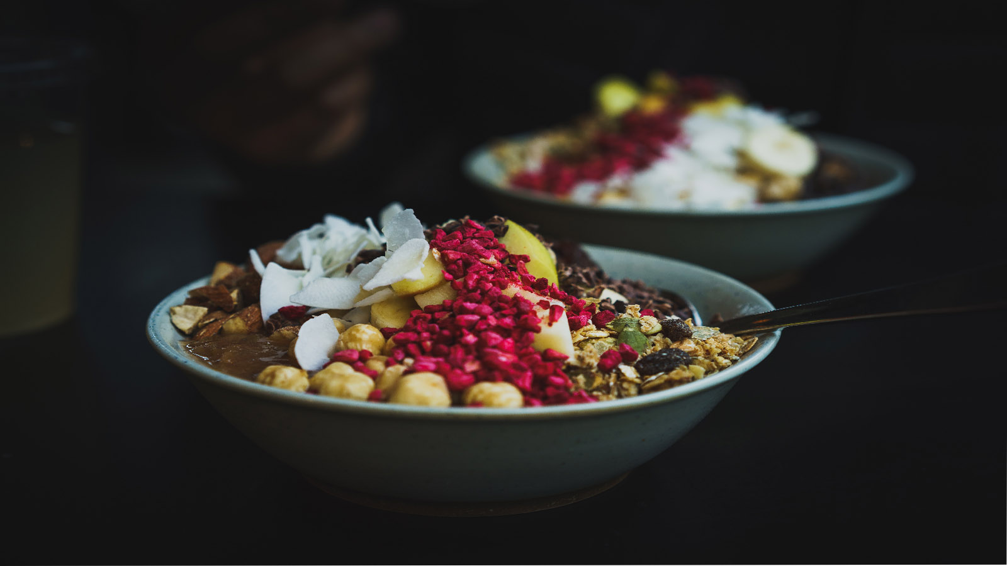
Notes:
Seed: edible thing Generator: Full Screen Google Images Context: {'topic': 'tacos', 'presenter': 'Lettie O. Lantigua', 'seed': 'edible thing'} Generated Elements: [None, '/downloads/google_images/edible thing/edible_1600x900.jpg', True]

Slide 9

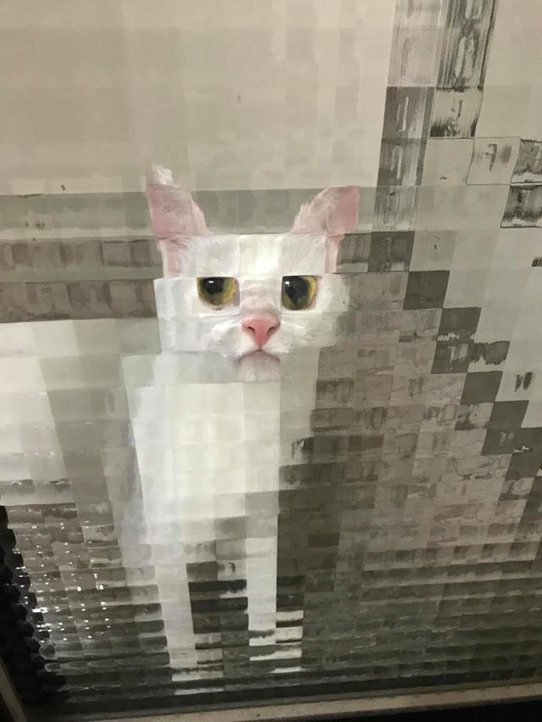
Let's look at Ediblestuffs
True
Good
Better
/app/talkgenerator/schema/../../downloads/reddit/hmmm+hmm+wtf+wtfstockphotos+photoshopbattles+confusing_perspective+cursedimages+HybridAnimals+EyeBleach+natureismetal/7r0ytbmcfas21.jpg
Notes:
Seed: ediblestuff Generator: Three Captions Weird Context: {'topic': 'tacos', 'presenter': 'Lettie O. Lantigua', 'seed': 'ediblestuff', 'seed_is_noun_plural_title': 'Ediblestuffs'} Generated Elements: ("Let's look at Ediblestuffs", 'Good', '/app/talkgenerator/schema/../../downloads/reddit/gifs+gif+gifextra+nonononoYES/ml9enuwvdxu21.gif', 'Better', '/app/talkgenerator/schema/../../downloads/reddit/hmmm+hmm+wtf+wtfstockphotos+photoshopbattles+confusing_perspective+cursedimages+HybridAnimals+EyeBleach+natureismetal/s7stznr1t3u21.jpg', '/app/talkgenerator/schema/../../downloads/reddit/hmmm+hmm+wtf+wtfstockphotos+photoshopbattles+confusing_perspective+cursedimages+HybridAnimals+EyeBleach+natureismetal/7r0ytbmcfas21.jpg', True)

Slide 10
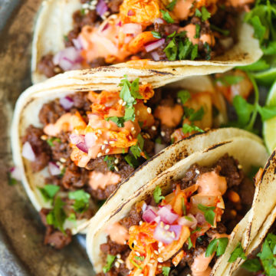
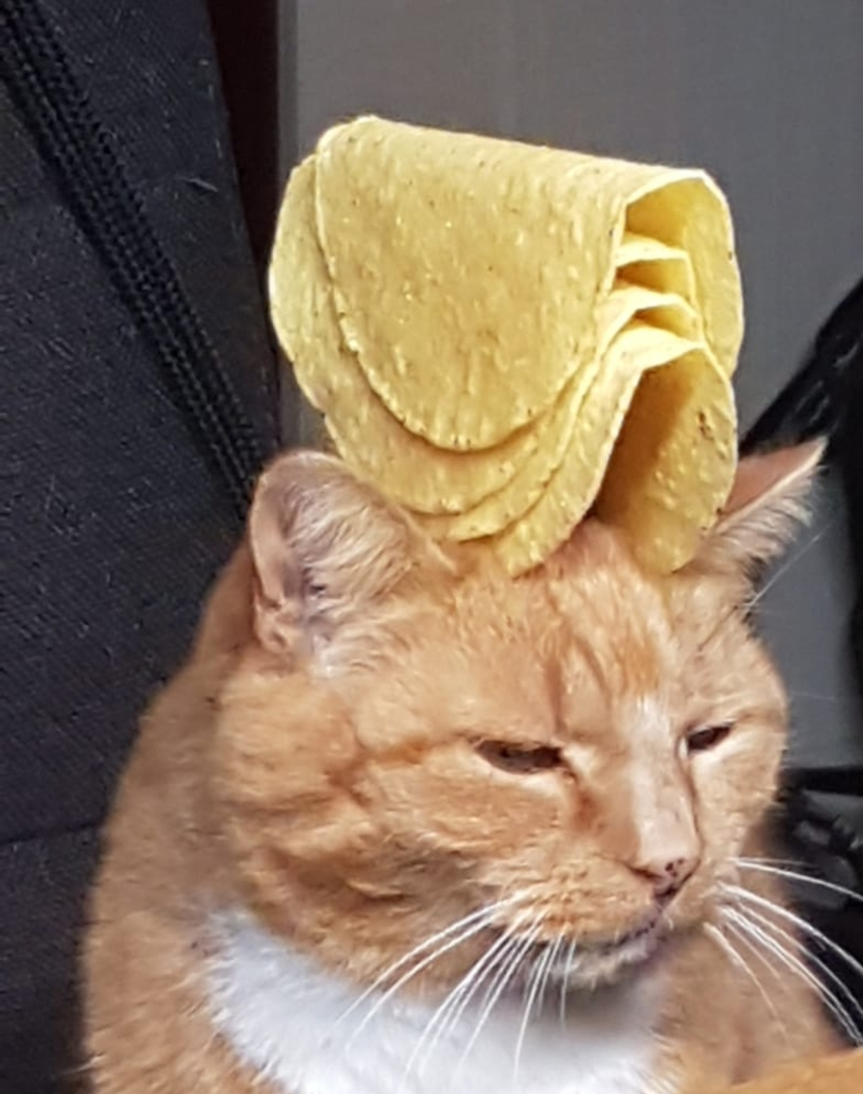
Conclusion
Conclusion 1
Conclusion 2
Notes:
Seed: tacos Generator: Conclusion Context: {'topic': 'tacos', 'presenter': 'Lettie O. Lantigua', 'seed': 'tacos'} Generated Elements: ['Conclusion', 'Conclusion 1', '/downloads/google_images/tacos/korean-beef-tacosimg_6959-360x360.jpg', 'Conclusion 2', '/app/talkgenerator/schema/../../downloads/reddit/hmmm+hmm+wtf+wtfstockphotos+photoshopbattles+confusing_perspective+cursedimages+HybridAnimals+EyeBleach+natureismetal/wve03mlofyv11.jpg', True]

